Slide 1


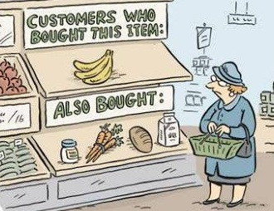
Recommendation Systems A Study of Different Approaches
Supervisor, Presented By,
Prof. Neil Bergmann Arjun C
44632339

Slide 2
Motivation
Commercially, one of the most used applications of machine learning
Information overload problem
Limited amount of libraries
Covers wide range of machine learning topics
Industry requirements
Job opportunities

Slide 3
Contents
Introduction
Aim & Scope
Research questions
Literature review
State-of-the-art
Theory
Implementation
Results
Discussion
Conclusion

Slide 4
Introduction
Recommendation Systems – Tools to help in suggesting items to users on the basis of past behavior.
Which cell phone should I buy? What is the best holiday deal for my family? Which is the best insurance policy for me? Which movie should I watch? Which web sites will I find interesting? Which book should I buy for my next vacation? Which degree and university are the best for my future? What courses should I select?

Slide 5

Introduction
Need for recommendation System – Information overload problem.

Slide 6
Aim & Scope
Aim
Understand and Implement different methods to build recommendation systems
Scope
There are a variety of methods available currently
Popularity based method, content based method, collaborative filtering using matrix factorization and autoencoders are considered
Hybrid models and many other algorithms are out of scope

Slide 7
Research questions
What are the different ways of building Recommendation systems?
What type of system suits best for what kind of requirement?
How expensive are these approaches?
How do we evaluate the effectiveness of the system?
Is the evaluation of the systems really meaningful?

Slide 8
History
Tapestry
Developed by Xerox, Palo Alto in the early 1990’s [1]
To help the users in getting relevant articles and documents by mail
Grouplens
Another similar system based on text service for news articles [2]
They further released the movielens dataset

Slide 9
Literature review - History
Why Tapestry ?
Mails contained documents and articles which were not relevant to the users.
The above problem could be solved by creating mailing lists. (E.g. Funny articles list, News list etc.) This could help users to subscribe users only to the interested mailing lists.
However, the list of documents of interest for a particular user never usually mapped to created lists. To solve this, filters were implemented using which users could subscribe to documents belonging to any mailing lists but filtering what they need using queries.
This filtering could be improved by using human help by tagging documents as belonging to particular type. So, whenever some users tag the documents as belonging to a particular type, the users who have subscribed and filtering such documents receive them by mail. Thus came the idea of collaborative filtering [1].

Slide 10
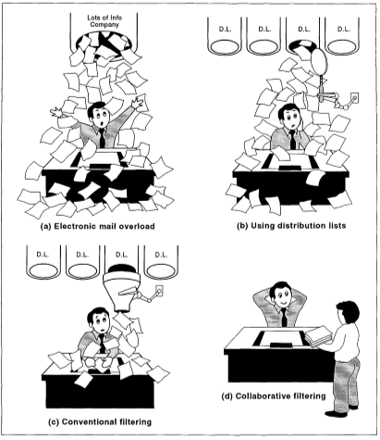
Literature Review - Tapestry
Why Tapestry ? [1]

Slide 11
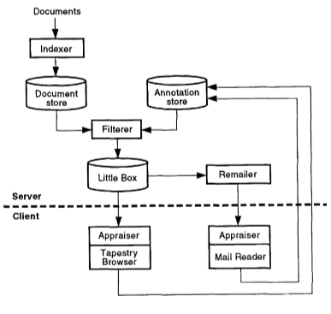
Literature Review - Tapestry
Tapestry Architecture [1]

Slide 12
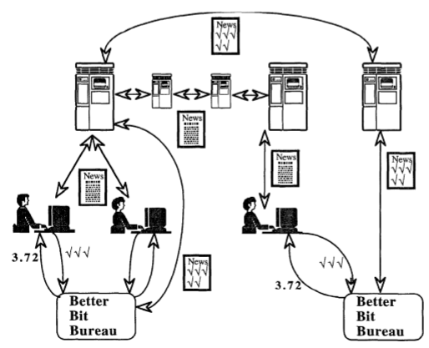
Literature Review - Grouplens
Grouplens Architecture [2]

Slide 13
Literature Review - Grouplens
Huge increase in the number of articles
Impossible to manage by an admin
User-based collaborative approach
Identify similar users using their ratings
Recommend items liked by the other

Slide 14
Literature Review - State-of-the-art
With the proposed implementations (Tapestry and Grouplens), it sparked improvements in this field.
Some of the most widely used algorithms now include
Popularity based method
Content Based filtering
Collaborative filtering
Hybrid approaches

Slide 15
Literature Review – Popularity based method
Popularity based recommendation systems are the most simple implementations that could be used to recommend items to the users. [3]
The idea behind this method is very simple.
Recommend the most rated items to the users as recommendation. This lacks even the slightest idea of personalization and is the easiest ways to build recommendations.
There is not really a way to evaluate these systems.

Slide 16
Literature Review – Content based filtering
As discussed in [3,4], this method is mainly reliant on the item description or the user features description.
In the case of movielens dataset, each movie is categorized as belonging to a set of genres.
If Alice likes a movie “Toy Story”, which belongs to “Animation” and “Children” genres, the system has to identify movies that belong to these genres.
The movie similarity is calculated using distance measures like cosine similarity.
This is still a good method given the categorization of data on the web.

Slide 17
Literature Review – Collaborative filtering
This method is based on predicting ratings for unrated movies based on similarities in the ratings between users.
E.g. if Alice has rated four movies as 5,5,2,1 and Bob has rated three movies as 5,4,*,1, then Alice and Bob are identified to have similar liking. Then, the unrated third movie’s rating would be estimated to be very close to 2.
The major techniques used are to implement this are Matrix Factorization [5,6] and Autoencoders [7-9]

Slide 18
Literature Review – Matrix Factorization
Identify low rank matrices such that when multiplying them we get the ratings matrix.
There are multiple variations of matrix factorization methods that are used. Some of the most common are Singular Value Decomposition (SVD), Non-negative Matrix Factorization and a custom implementation proposed for Netflix Prize challenge [5]

Slide 19
Literature Review – Autoencoders
Dimension reduction method used to compress images in general.
They could be used to identify latent features to predict user ratings.
This is being used for recommendations and a lot of researches are trying to extend the basic version to get better results.
Some of the extensions are denoising autoencoders, stacked autoencoders

Slide 20
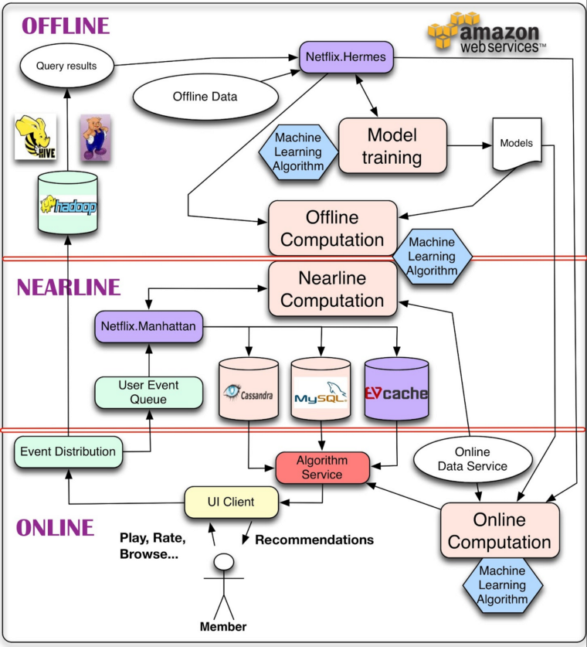
Literature Review – Netflix implementation
Netflix Recommendation Systems Architecture [10]

Slide 21
Literature Review – Netflix implementation
Offline Task
Carried out on offline data. No realtime response required.
Online task
Responds in realtime
Nearline task
Intermediate between online and offline. Computations happen like online, but no realtime responses.
We will focus on offline task

Slide 22
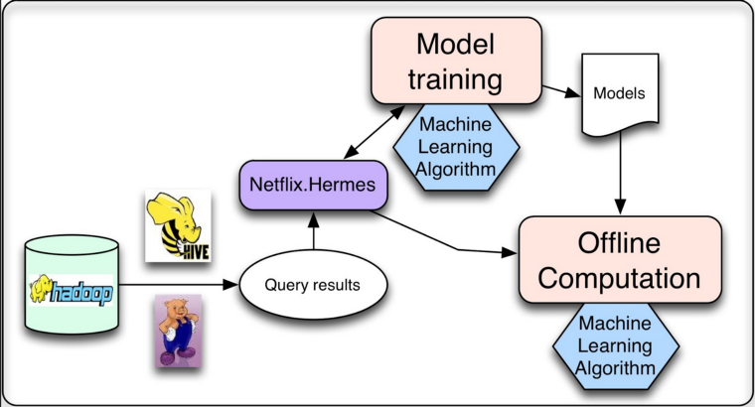
Literature Review – Netflix implementation
Divided into Model training and Batch computation
Model training – Build a learning model using all the available data. Store the built model.
Batch computation – Use the saved model to perform online computations
Training task is run periodically
Netflix Offline Task Architecture [10]

Slide 23
Literature Review – Netflix prize challenge
A competition was launched by Netflix challenging the community to build models that could reduce the eixisting RMSE by atleast 10%.
A cash prize of 1 Million was offered [5].
This shown how important Recommendation systems.
It was noted that 35% of the sales on Amazon are the recommendations
Also, recommendations on Google news has increased the clicks by 38%.

Slide 24
Literature Review – Evaluation
Two types
Online and Offline
Online – Use user feedback
Offline – Use available dataset to evaluate the system
Online – Can be done using explicit feedback (ratings by the user) and implicit feedback (tracking item lookups or clicks)
We consider offline methods for this study as the dataset is available and there is no access to a live system.

Slide 25

Literature Review – Evaluation
Root Mean Squared Error (RMSE)
Calculated only on the known ratings by the users. Other metrics like Mean Squared error or Sum of Squared errors could also be used

Slide 26
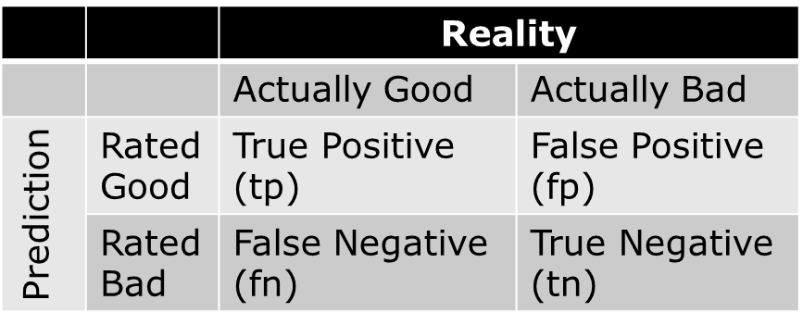
Literature Review – Evaluation
Precision and Recall

Slide 27
Theory
Popularity based method
Content based filtering method
Collaborative filtering method
Hybrid method
Evaluating the systems

Slide 28
Theory – Popularity based method
System recommends items with most number of user ratings or reviews
Problem Statement
Given a set of users U = {u₁, u₂, . . . . , u_{m}} and a set of movies M = { m₁, m₂, . . . . , m_{n} } and the ratings by the users for the movies R = { r_{1,1} , r_{1,2} , . . . . , r_{m,n}}, the system has to identify the top N movies that have received the highest number of ratings.

Slide 29
Theory – Popularity based method
When to use this type of system ?
No information on users or items features
Limited computation resources
Simple implementation
No need for personalization

Slide 30
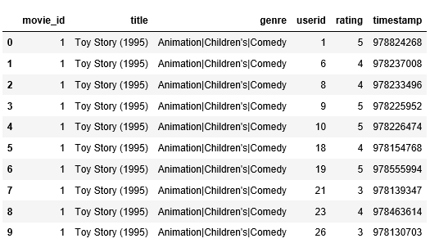
Theory – Popularity based method
Sample data

Slide 31
Theory – Popularity based method
Implementation
Initially, the data is processed to convert to the format shown above.
The count of ratings for each movie are calculated.
This list of movies is then sorted on the basis of the number of ratings.
Top N of the above generated list are recommended to the users.

Slide 32
Theory – Popularity based method
Evaluation
This model does not require any evaluation metrics given that it recommends the same items to all users. This may not be the most useful model, but it is quite surprising to know that this model is used by a lot of websites.

Slide 33
Theory – Content based filtering
Problem statement
Given a set of movies and their genres, identify top N movies given a movie belonging to a set of genres.
When to use this type of system?
When all the features of the items or user preferences are given

Slide 34
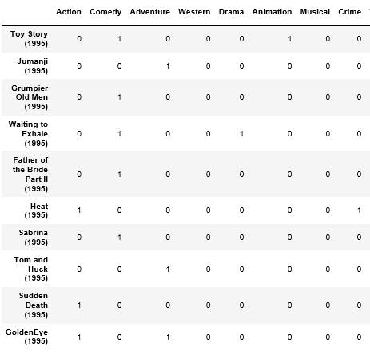
Theory – Content based filtering
Sample data

Slide 35
Theory – Content based filtering
Example
 | Genre1 | Genre2 | Genre3 | Genre4
Movie1 | 1 | 1 | 0 | 0
Movie2 | 1 | 0 | 0 | 1
Movie3 | 1 | 1 | 0 | 0
Movie4 | 1 | 0 | 0 | 1
Movie5 | 1 | 1 | 0 | 0

Slide 36
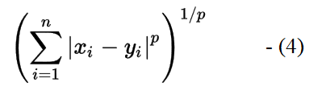
Theory – Content based filtering
Implementation
Transform data to matrix as in sample data
Fit nearest-neighbor model
Get predictions
Evaluation
Train and test sets were created and model was built. Then model was evaluated using average minkowski distance over all the test points.
The approximate result was found to be 0.05.

Slide 37
Theory – Collaborative filtering
The problem statement for Collaborative filtering could be defined as follows. The problem can be modeled by the triplet (U, I, R), where,
• U is the set of users
• I is the set of items (movies) in our case
• R is the set of ratings for movies by the users. (values ranging from 1-5 for rated movies and 0 for unrated movies)
A realization of (U, I, R) denoted by (u, i, r) means that user u rated item i with value r. The goal of this system is to estimate R from (U,I) such that the RMSE is minimum.

Slide 38
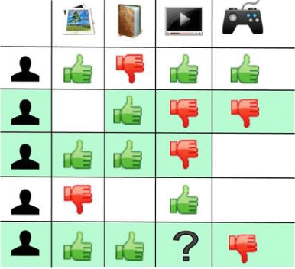
Theory – Collaborative filtering
Intuition
Issues Faced
Cold Start Problem
Data Sparsity
Scalability

Slide 39
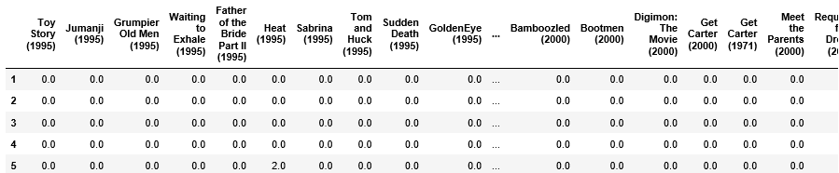
Theory – Collaborative filtering
Sample data

Slide 40
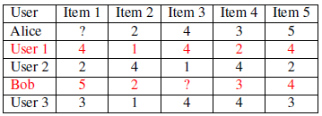
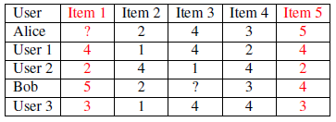
Theory – Collaborative filtering
Types
Memory based and Model based
Memory based
User-User based
Item-Item based

Slide 41
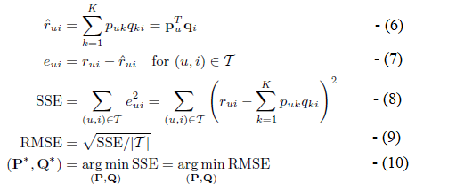
Theory – Collaborative filtering
Model based
Matrix Factorization
Given ratings matrix R, identify low rank matrices P and Q such that,
R = PQ -(5)

Slide 42

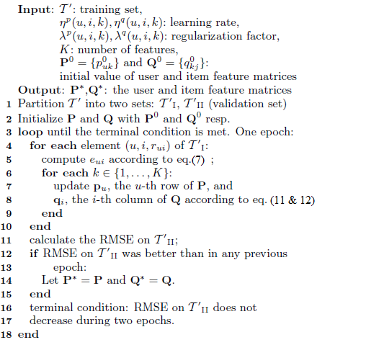
Theory – Collaborative filtering
Evaluated using RMSE on known ratings

Slide 43
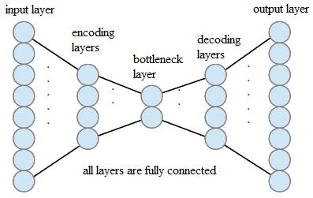
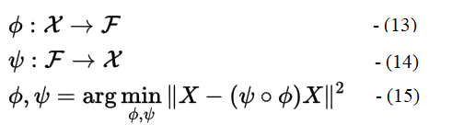
Theory – Collaborative filtering
Autoencoders
z = σ (Wx + b) - (16)
x` = σ`(W`z + b`) - (17)
Evaluated using RMSE on known ratings

Slide 44

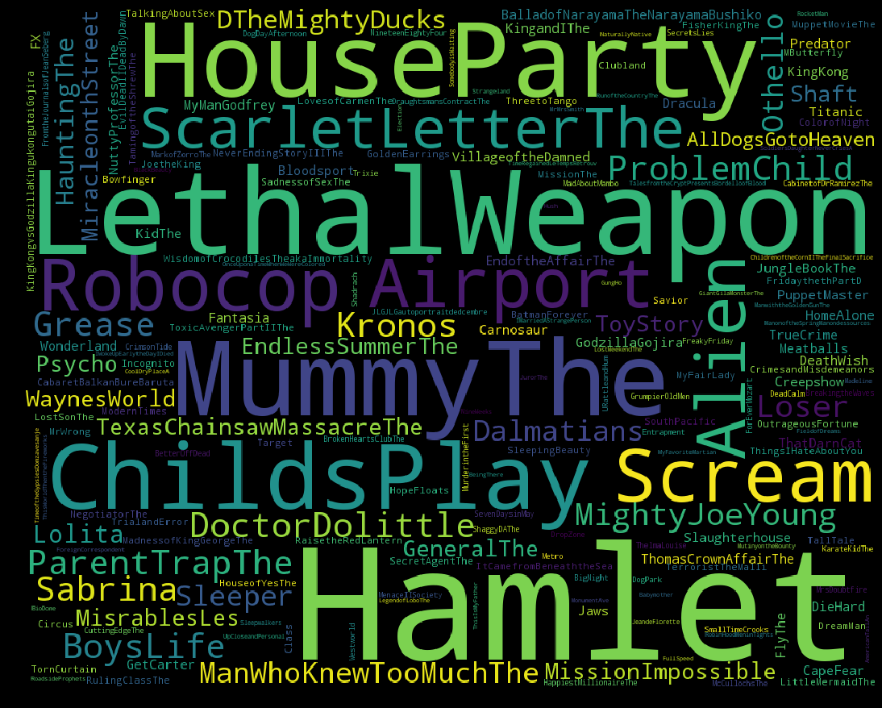
Results – Data Analysis
Data Sparsity : 95.76%

Slide 45
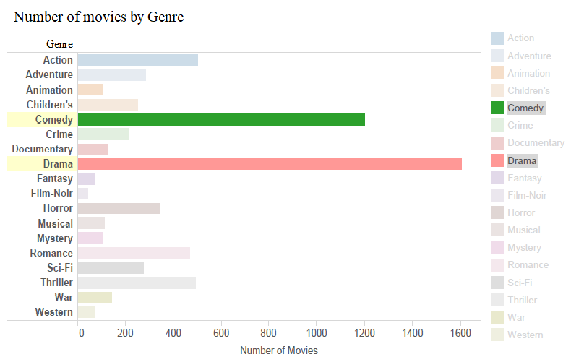
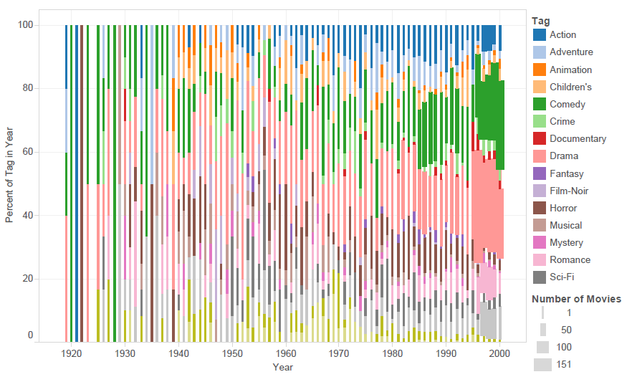
Results – Data Analysis

Slide 46
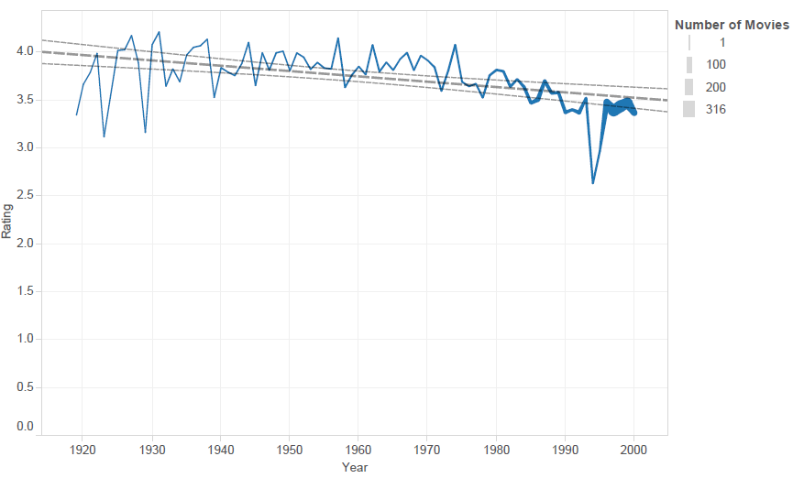
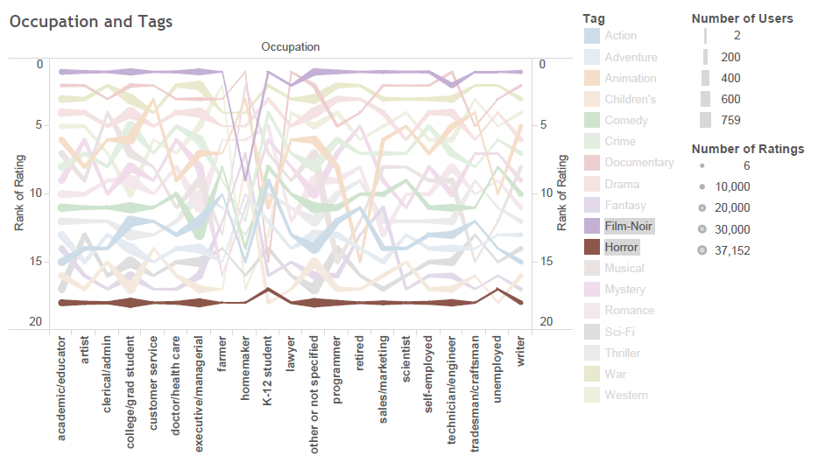
Results – Data Analysis

Slide 47
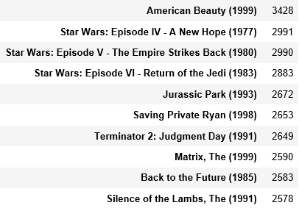
Results – Popularity based method

Slide 48
Results – Content Based Method
Movies Similar to Toy Story (1995)
Toy Story (1995)
Adventures of Rocky and Bullwinkle, The (2000)
Rugrats Movie, The (1998)
Chicken Run (2000)
American Tail: Fievel Goes West, An (1991)
Toy Story 2 (1999)
Bug's Life, A (1998)
Aladdin and the King of Thieves (1996)
American Tail, An (1986)
Saludos Amigos (1943)
Average RMSE of 0.05 on Minkowski distance on test set

Slide 49
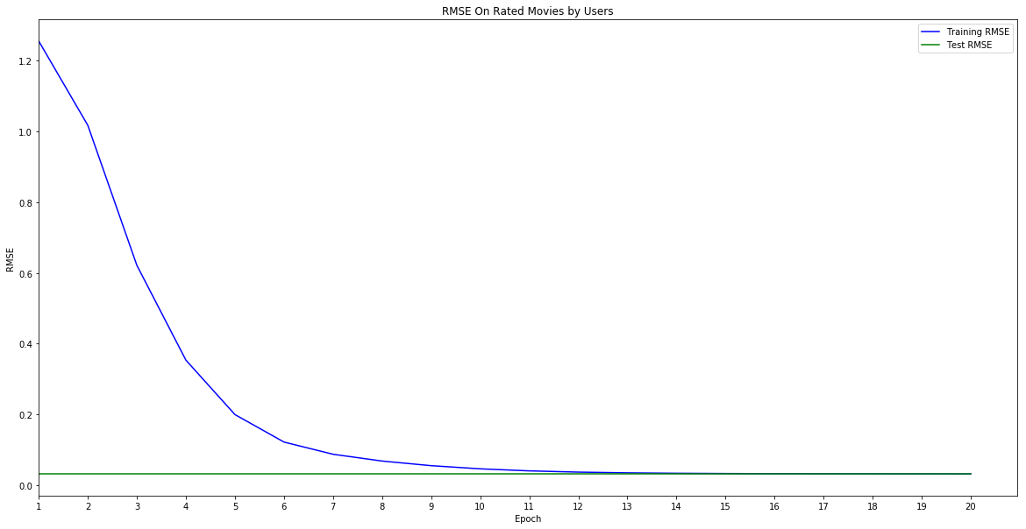
Results – Matrix Factorization method
This method was not successful in using on the actual movielens dataset because of the data sparsity of 95.76% and the computation complexity given the number of elements to be visited per iteration
However, this was implemented on a sample dense matrix to make sure the algorithm was coded right

Slide 50
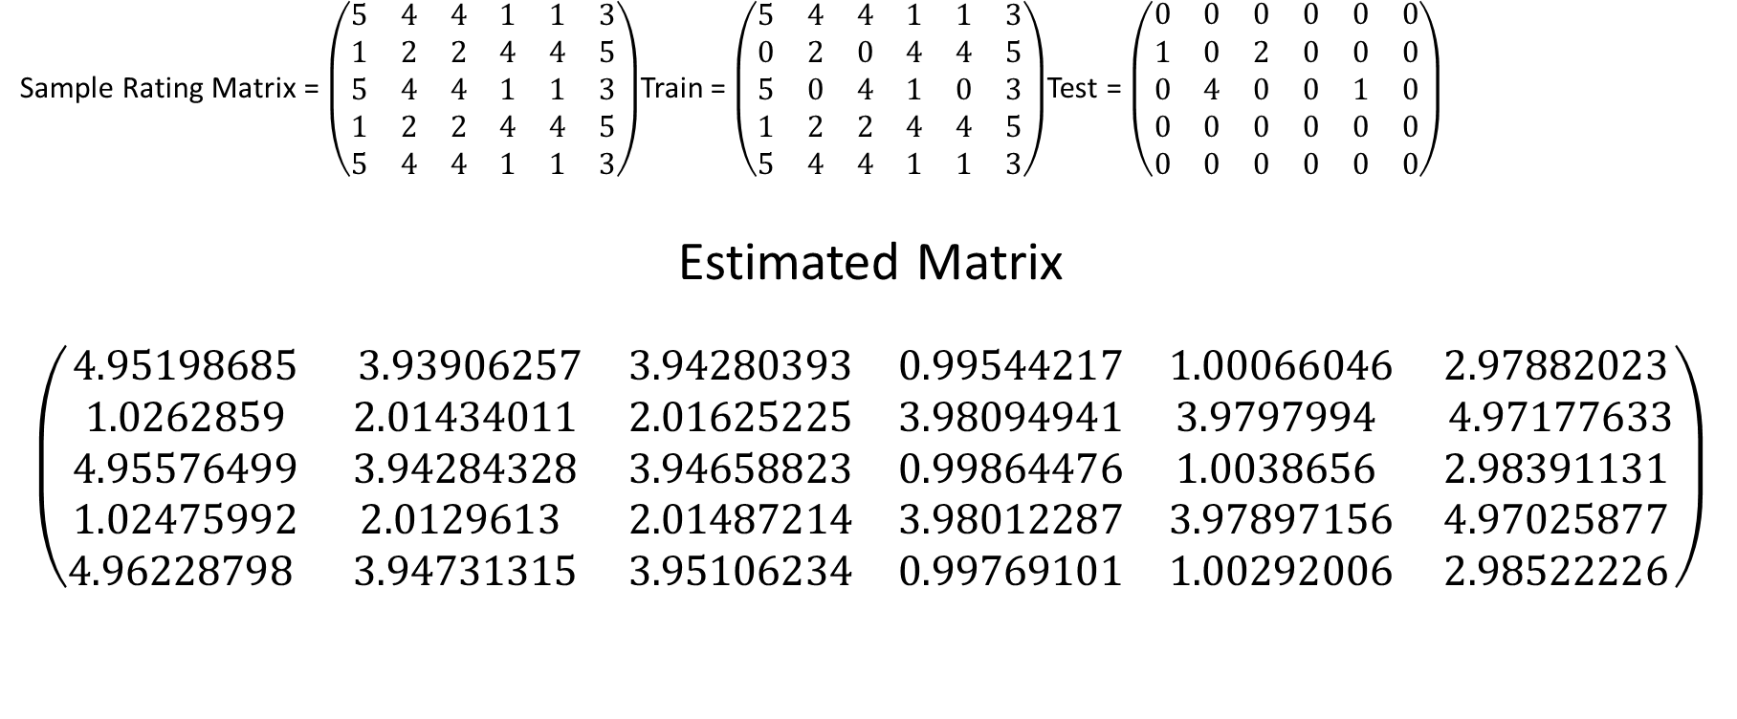
Results – Matrix Factorization method
Sample Rating Matrix = $\left(\begin{matrix}5 & 4 & 4 & 1 & 1 & 3 \\ 1 & 2 & 2 & 4 & 4 & 5 \\ 5 & 4 & 4 & 1 & 1 & 3 \\ 1 & 2 & 2 & 4 & 4 & 5 \\ 5 & 4 & 4 & 1 & 1 & 3\end{matrix}\right)$Train = $\left(\begin{matrix}5 & 4 & 4 & 1 & 1 & 3 \\ 0 & 2 & 0 & 4 & 4 & 5 \\ 5 & 0 & 4 & 1 & 0 & 3 \\ 1 & 2 & 2 & 4 & 4 & 5 \\ 5 & 4 & 4 & 1 & 1 & 3\end{matrix}\right)$Test = $\left(\begin{matrix}0 & 0 & 0 & 0 & 0 & 0 \\ 1 & 0 & 2 & 0 & 0 & 0 \\ 0 & 4 & 0 & 0 & 1 & 0 \\ 0 & 0 & 0 & 0 & 0 & 0 \\ 0 & 0 & 0 & 0 & 0 & 0\end{matrix}\right)$
Estimated Matrix
$$\left(\begin{matrix}4.95198685 & 3.93906257 & 3.94280393 & 0.99544217 & 1.00066046 & 2.97882023 \\ 1.0262859 & 2.01434011 & 2.01625225 & 3.98094941 & 3.9797994 & 4.97177633 \\ 4.95576499 & 3.94284328 & 3.94658823 & 0.99864476 & 1.0038656 & 2.98391131 \\ 1.02475992 & 2.0129613 & 2.01487214 & 3.98012287 & 3.97897156 & 4.97025877 \\ 4.96228798 & 3.94731315 & 3.95106234 & 0.99769101 & 1.00292006 & 2.98522226\end{matrix}\right)$$

Slide 51
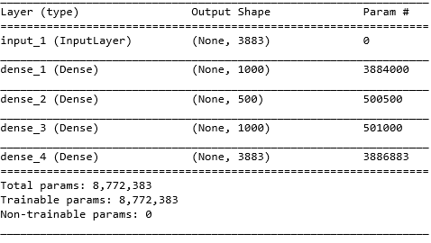
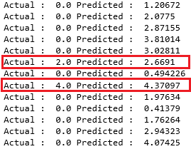
Results – Autoencoder

Slide 52
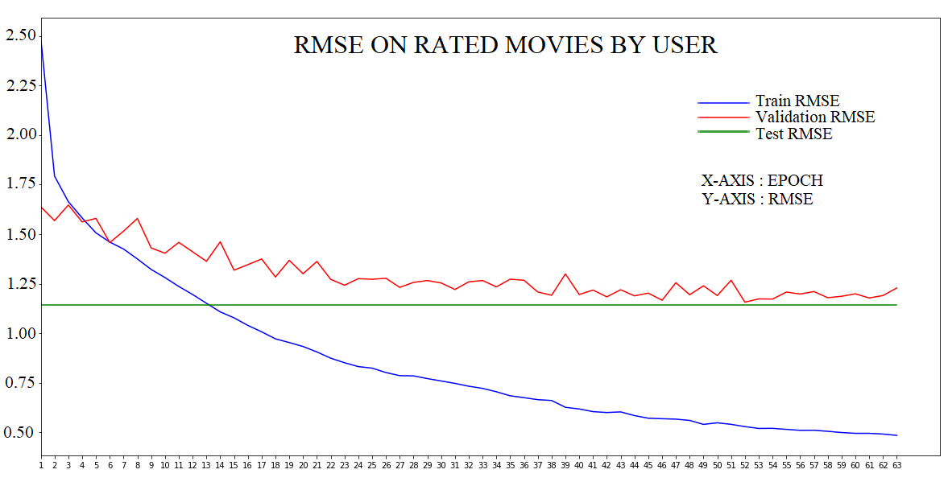
Results – Autoencoder
Test RMSE = 1.14

Slide 53
Discussion
Popularity based method was the simplest to implement, performs well with no personalization whatsoever.
Content based method performs well given the simplicity of nearest neighbor method. It is reliant on items features, hence not preferable.
Matrix factorization, even though known to perform well, which actually won the Netflix prize challenge, suffers from scalability issues and data sparsity. This could be improved using high performance computing
Auto encoders perform reasonably well in very less time. There is scope for improvement in this case.

Slide 54
Discussion
What are the different ways of building Recommendation systems?
What type of system suits best for what kind of requirement?
How expensive are these approaches?
How do we evaluate the effectiveness of the system?
Is the evaluation of the systems really meaningful?

Slide 55
Conclusion
Intended methods were successfully implemented and evaluated.
Matrix factorization did not reach a stable point due to data sparsity.
There are some possible glitches in the autoencoder implementations as well.
Popularity based method and Content based method meet their requirement effectively unlike collaborative filtering.
Given the issues faced by Collaborative filtering and the limitations of other methods, it is better to use a combination of models to build recommendations.
No evaluation metric can exactly tell if the system is good.
Thesis could be used as starting point by a new-comer to the field.

Slide 56
Future work
These implementation could be improved using combination of models (hybrid)
Popularity + Collaborative filtering could solve cold start problem
Popularity + Content based filtering helps in giving popular relevant results
Content Based + Collaborative filtering could help in improving the recommendations (major research is being carried out in this area)
Currently, hybrid systems are the way to go, thus

Slide 57
References
[1] D. Goldberg, D. Nichols, B. Oki, and D. Terry, "Using collaborative filtering to weave an information tapestry," Communications of the ACM, vol. 35, no. 12, pp. 61-70, 1992.
[2] P. Resnick, N. Iacovou, M. Suchak, P. Bergstrom, and J. Riedl, "GroupLens: an open architecture for collaborative filtering of netnews," ed, 1994, pp. 175-186.
[3] C. C. Aggarwal, Recommender Systems The Textbook. Cham: Cham : Springer International Publishing : Imprint: Springer, 2016.
[4] P. Pirasteh, J. J. Jung, and D. Hwang, "Item-based collaborative filtering with attribute correlation: A case study on movie recommendation," vol. 8398, ed, 2014, pp. 245-252.
[5] G. Takács, I. Pilászy, B. Németh, and D. Tikk, "Matrix factorization and neighbor based algorithms for the netflix prize problem," ed, 2008, pp. 267-274.

Slide 58
References
[6] E. Kharitonov, "Empirical Study of Matrix Factorization Methods for Collaborative Filtering," in Pattern Recognition and Machine Intelligence: 4th International Conference, PReMI 2011, Moscow, Russia, June 27 - July 1, 2011. Proceedings, S. O. Kuznetsov, D. P. Mandal, M. K. Kundu, and S. K. Pal, Eds. Berlin, Heidelberg: Springer Berlin Heidelberg, 2011, pp. 358-363.
[7] Y. Ouyang, W. Liu, W. Rong, and Z. Xiong, "Autoencoder-Based Collaborative Filtering," in Neural Information Processing: 21st International Conference, ICONIP 2014, Kuching, Malaysia, November 3-6, 2014. Proceedings, Part III, C. K. Loo, K. S. Yap, K. W. Wong, A. T. Beng Jin, and K. Huang, Eds. Cham: Springer International Publishing, 2014, pp. 284-291.
[8] S. Sedhain, A. Menon, S. Sanner, and L. Xie, "AutoRec: Autoencoders Meet Collaborative Filtering," ed, 2015, pp. 111-112.
[9] J. Wei, J. He, K. Chen, Y. Zhou, and Z. Tang, "Collaborative filtering and deep learning based recommendation system for cold start items," Expert Systems With Applications, vol. 69, pp. 29-39, 2017.
[10] X. Amatriain and J. Basilico. (2013). System Architectures for Personalization and Recommendation. Available: https://medium.com/netflix-techblog/system-architectures-for-personalization-and-recommendation-e081aa94b5d8

Slide 59

Thank You
If you liked the ideas presented, you may also like:
Machine Learning : COMP7703
Data Mining : INFS7203
Information Retrieval & Web Search : INFS7410

